Slide 1
House Price Predictor
AI Lab Task No 1
From: M Haroon Abbas
2K23/ BLCS/ 38
Course Instructor: Dr Fozia Talpur

Slide 2
Objectives
The Goal: To Predict House Prices according to given features as input
Predictive Task: Estimate the SalePrice of residential properties.
Key Predictors:
Overall Qual: Material and finish quality.
Gr Liv Area: Above-ground living area square feet.
Garage Cars: Size of garage in car capacity.
Total Bsmt SF: Total square feet of basement area.
Year Built : Build Year
Pipeline Scope: Data Cleaning -> EDA -> Feature Engineering -> Model Training ->FastAPI Deployment.

Slide 3
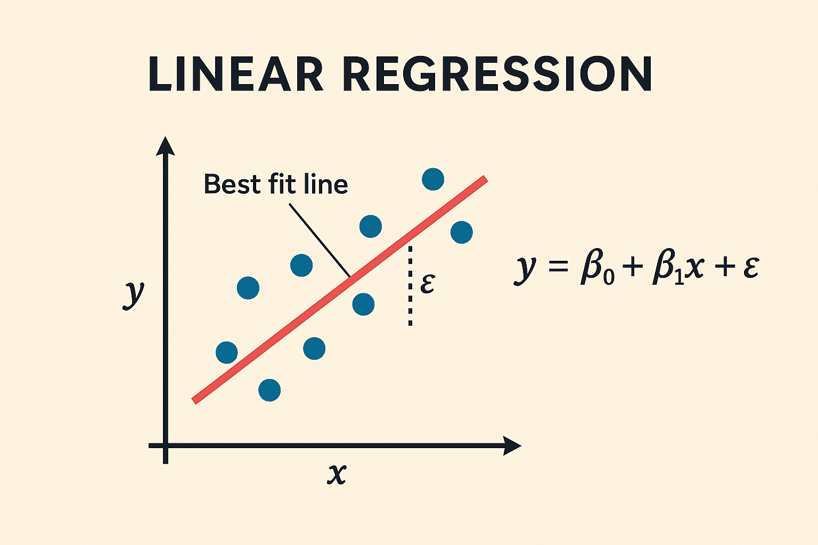
Algorithm
Linear Regression.
Why Linear Regression?
Nature of the Target: Price is a continuous numeric value, requiring a Regression approach rather than Classification.
Efficiency: It serves as the perfect "Baseline Model"—low computational cost with high transparency.

Slide 4
Understanding Evaluation Metrics
Since this is a regression problem, we evaluate the model using regression metrics, not classification metrics.
The two primary metrics used are:
R² (Coefficient of Determination)
RMSE (Root Mean Squared Error)
These metrics help us understand accuracy and error magnitude of predictions.

Slide 5
Understanding R² Score
R² measures how well the model explains the variance in the target variable.
R² ranges from 0 to 1 (or can be negative in poor models).
Interpretation:
R² = 0 → model explains nothing
R² = 1 → perfect prediction
In our model:
Validation R² ≈ 0.83
Test R² ≈ 0.77
This means the model explains 77–83% of house price variation, which is strong for Linear Regression.

Slide 6
Understanding RMSE (Root Mean Squared Error)
RMSE measures the average prediction error in the same unit as the target variable (price).
It penalizes larger errors more heavily due to squaring.
Our model results:
Validation RMSE ≈ 33,000
Test RMSE ≈ 44,000
This means predictions are off by about $33k–$44k on average, which is acceptable for real estate pricing.

Slide 7
Generalization Check
Validation and test scores are close to each other.
Small performance drop from validation to test indicates:
Model is not overfitting
Model generalizes well to unseen data
Large drops would indicate overfitting or data leakage, which is not observed here.

